Slide 1
Assessment Strategy Overview School of Electrical & Electronic Engineering
Assessment Integrity in the Era of Large Language Models: Threats and Opportunities within the UCD College of Engineering & Architecture
June 2023

Slide 2
100,000
513
116,849
modules offered by the
College of Engineering & Architecture in 2022/23
student credits taught* by the
College of Engineering & Architecture in 2022/23
66
20,580
modules offered by the
School of Electrical & Electronic Engineering
in 2022/23
student credits taught* by the
School of Electrical & Electronic Engineering
in 2022/23
38
Level 4
2
Level 5
School of Electrical & Electronic Engineering
number of modules by level
3
Level 1
8
Level 2
15
Level 3
47
5-credit modules offered within the School
4
10-credit modules offered within the School
15
15+-credit modules offered within the School
191
different assessed components within modules offered by the School of Electrical & Electronic Engineering
in 2022/23
ME Electronic & Computer Engineering
ME Electrical Power Engineering
flagship courses offered by the
School of Electrical & Electronic Engineering
Examination
most common assessment type used within modules
offered by the School of Electrical & Electronic Engineering
in 2022/23
Attendance
least common assessment type used within modules
offered by the School of Electrical & Electronic Engineering
in 2022/23
*Student Credits Taught = Module ECTS Credits × 2022/23 Enrolled Students

Slide 3
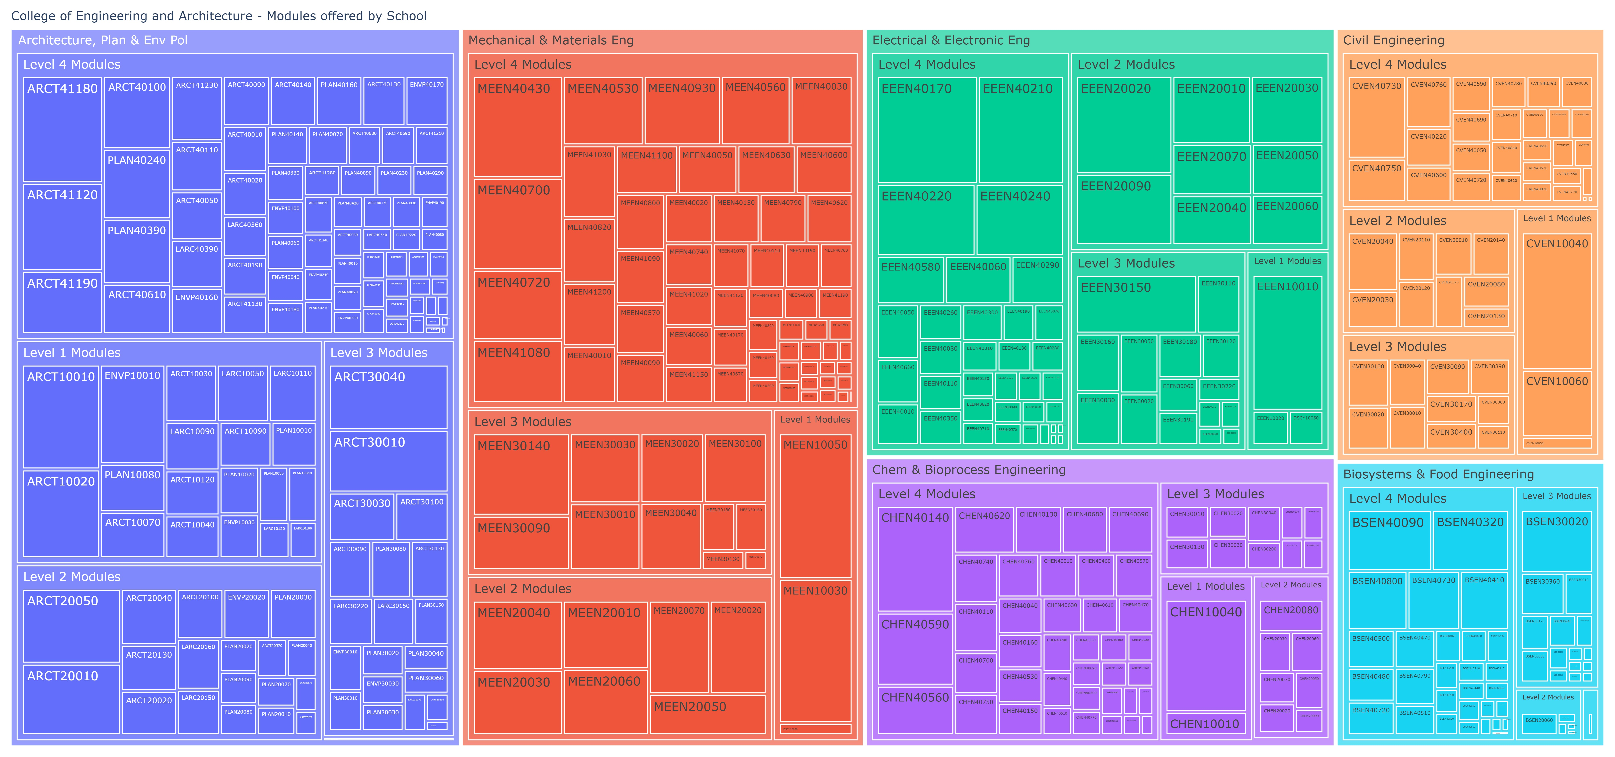
College of Engineering & Architecture – Modules by School
2022/23 Academic Year – Modules Weighted by Student Credits

Slide 4
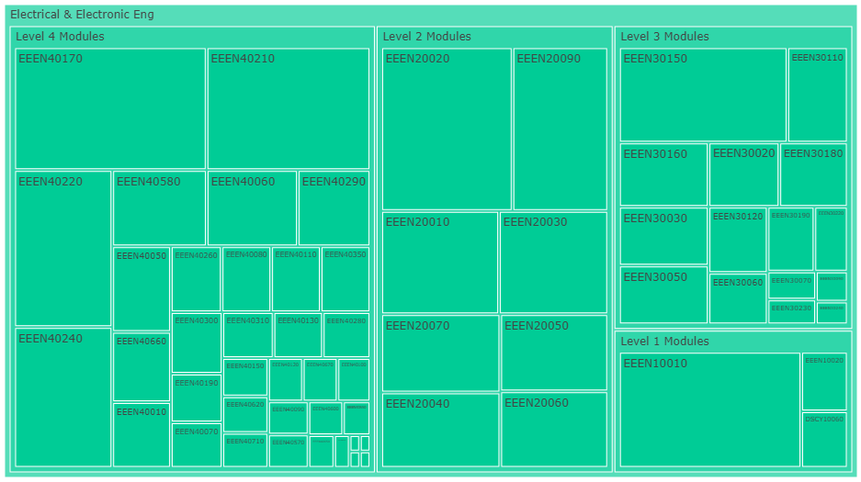

Slide 5
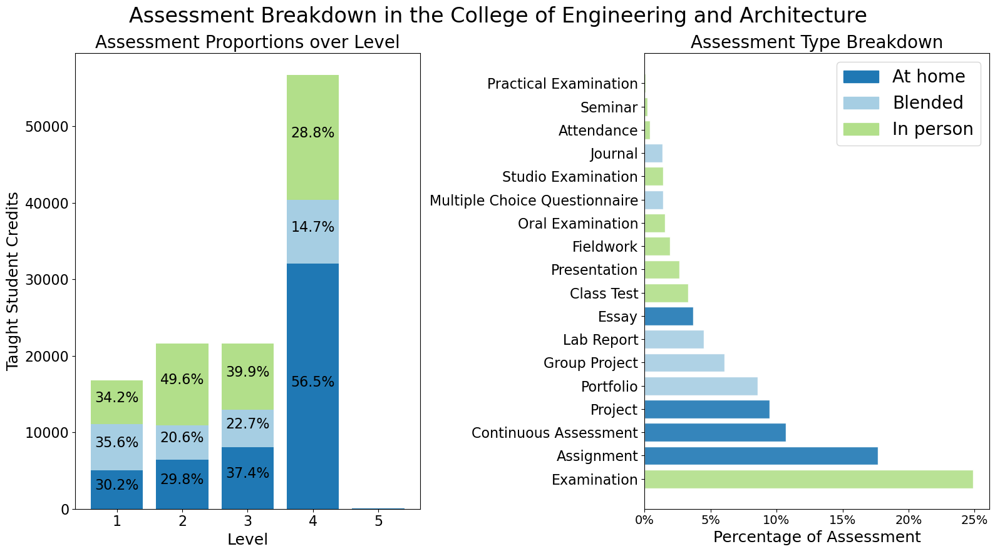
College of Engineering & Architecture

Slide 6
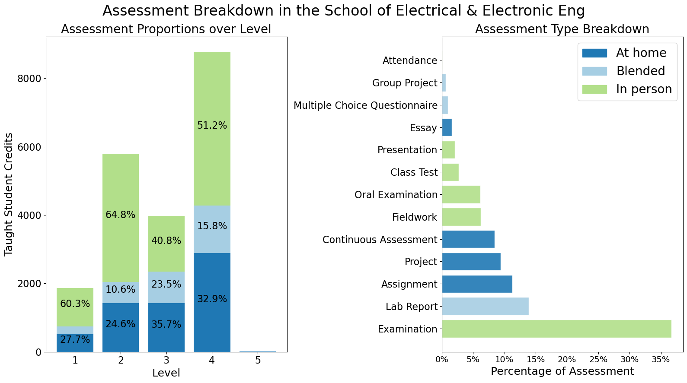
School of Electrical & Electronic Engineering

Slide 7
ME Electronic & Computer Engineering

Slide 8
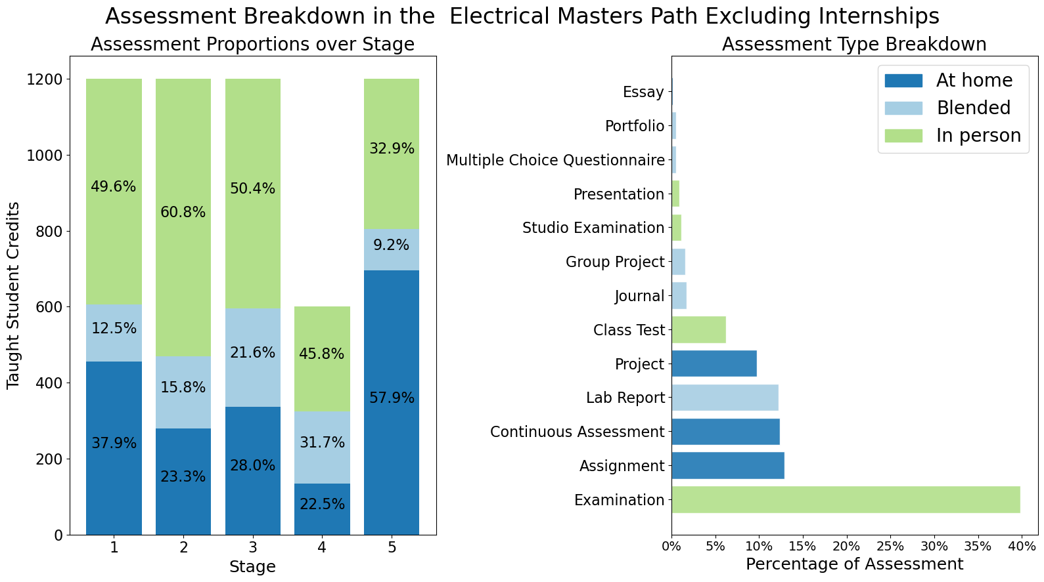
ME Electrical Power Engineering

Slide 9
Assessment Strategy Overview School of Electrical & Electronic Engineering Assessment Integrity in the Era of Large Language Models: Threats and Opportunities within the UCD College of Engineering & Architecture June 2023

